Slide 1

Nathaniel’s Vision board
2019-2020

Slide 2

Prosperity
The condition of being successful or thriving

Slide 3


Aspiration
A strong desire to achieve something high or great

Slide 4

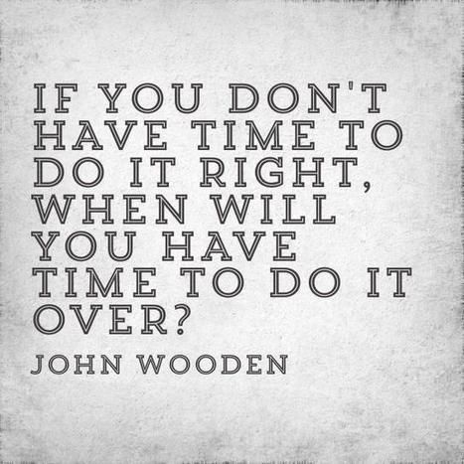
Time Management

Slide 5

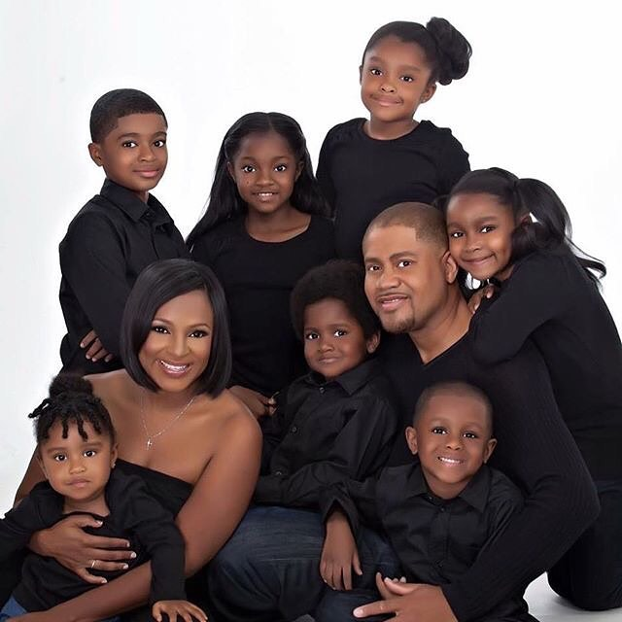
Family

Slide 6

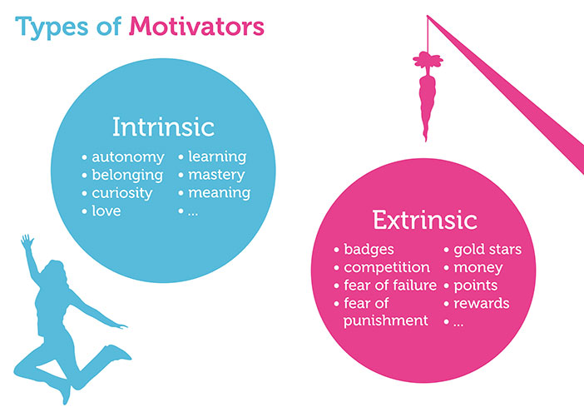

Motivators

Slide 7



Goals

Slide 8

Skills/ Knowledge

Slide 9


Career/ Life Path

Slide 10


Helpful People

